Slide 1
Touch For Food February 7 Meeting
CloudNine

Slide 2
Agenda
Activity on Node
Risk Management
Budget
Demo
Questions?

Slide 3
Risk Management
Schedule slips
Increase in effort
Procedural risks
QA
Bug basher
Flow fixer
Branches and code reviews

Slide 4
Risk Management
Technology risks
Added Finders/Output Mappers
Lost stakeholder
Found new stakeholder

Slide 5
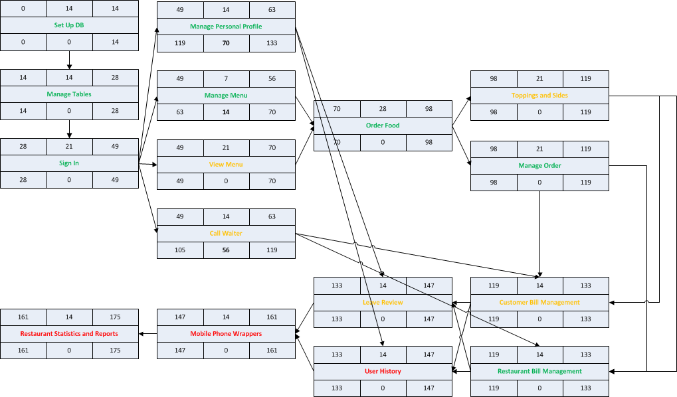
Activity on Node

Slide 6
Budget
Total person-hours budgeted to date: 3,726 ph
Total person-hours worked: 1,132 ph
Person-hours budgeted per sprint: 414 ph
Too high (46 hours per person)

Slide 7
Questions?

